Slide 1
The Town Mouse and the Country Mouse
A fable by Aesop

Slide 2
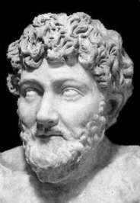
Aesop (620–564 BC)
A Greek storyteller credited with a number of fables now collectively known as Aesop's Fables. Many of the tales associated with him are characterized by the personification of animal characters.

Slide 3
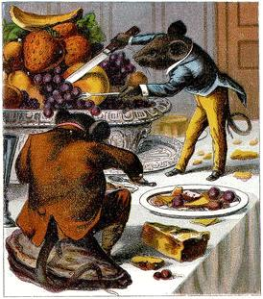
The Town Mouse and the Country Mouse
In the original tale, a proud town mouse visits his cousin in the country. The country mouse offers the city mouse a meal of simple country cuisine, at which the visitor scoffs and invites the country mouse back to the city for a taste of the "fine life" and the two cousins dine on white bread and other fine foods. But their rich feast is interrupted by a cat which forces the rodent cousins to abandon their meal and retreat back into their mouse hole for safety. Town mouse tells country mouse that the cat killed his mother and father and that he is frequently the target of attacks. After hearing this, the country mouse decides to return home, preferring security to opulence.

Slide 4
Let’s watch the fable now …

Slide 5
… and the moral is that …
poverty with security is better than wealth among fear and uncertainty.

